Slide 1

RESUME CLASSIFICATION
By:-
SHREYAS S
Ms. Divya Jeetu Jethani
Mr. Saranrraj A
Ms. Shivani Narvekar
Nayan Kumar Mallick
Mr. Pravin B. Shende
Mentor:- Karthik Muskula Date:-03/10/2022

Slide 2
BUSINESS OBJECTIVE
The resume classification solution should significantly reduce the manual human effort in the HRM.
Our model should achieve a higher level of accuracy and automation with minimal human intervention.

Slide 3
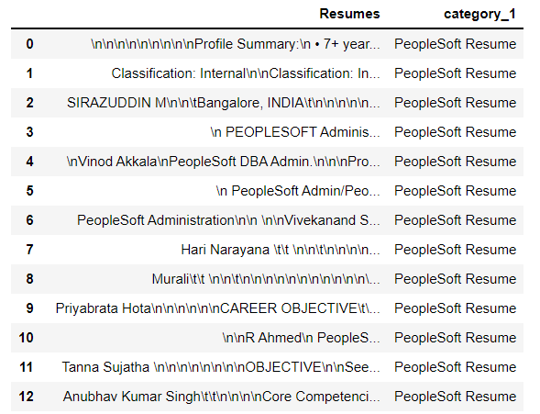
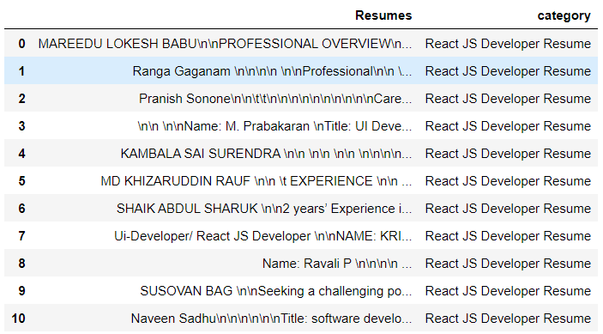
EXTRACTING THE DATA
So the data given by the client is in docx format.
We use NLTK library to extract the data.
We extract the data into some category like 'React JS Developer Resume','PeopleSoft Resume','SQL Developer Lightning Insight Resume'.

Slide 4
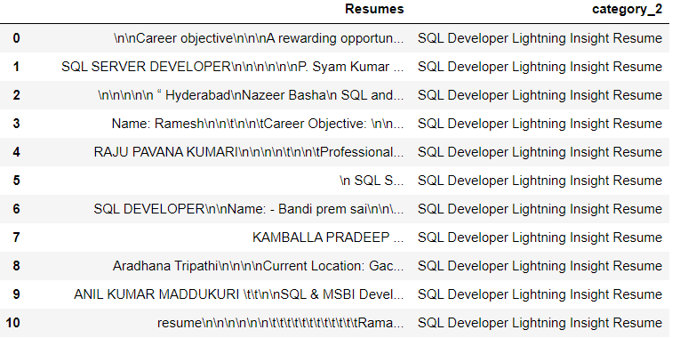
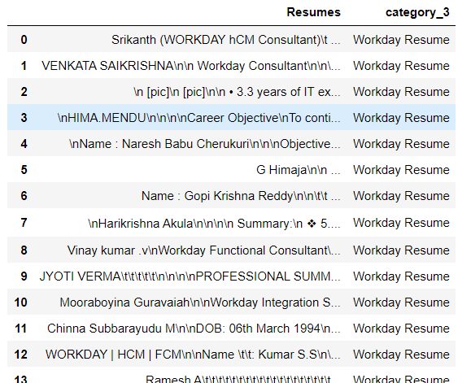

Slide 5
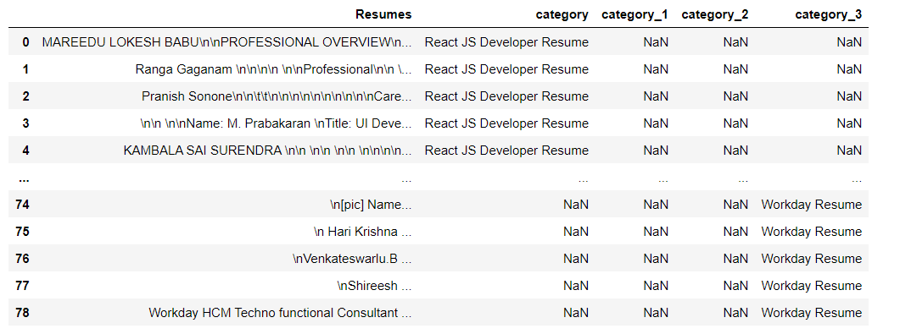
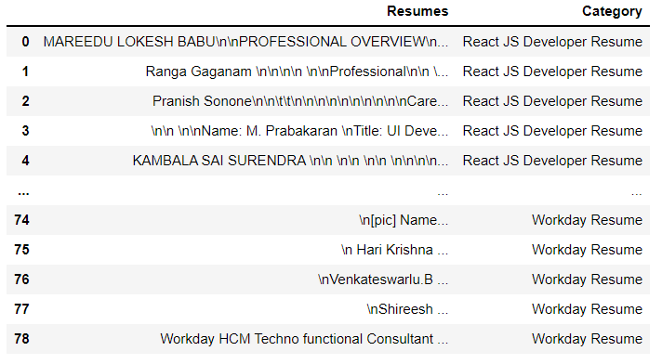
MAKING ONE DATAFRAME

Slide 6
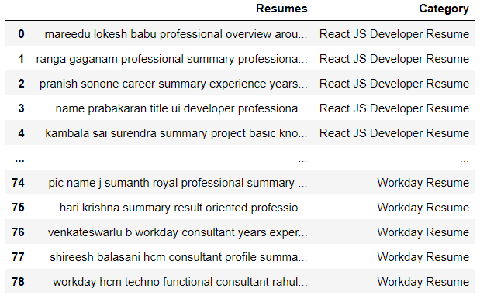
CLEANING THE DATA
As the previous data frame contain some unwanted symbols, so data cleaning is needed to remove it.

Slide 7

EDA
WORD CLOUD
The size of each word indicates the importance of it.

Slide 8
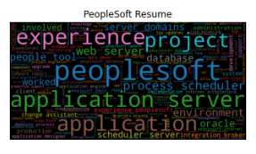
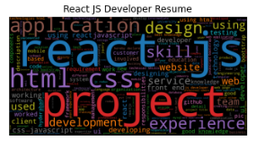
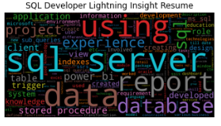
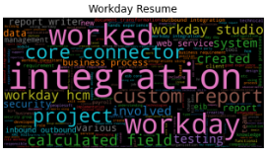
WORD CLOUD FOR EACH CATEGORY

Slide 9
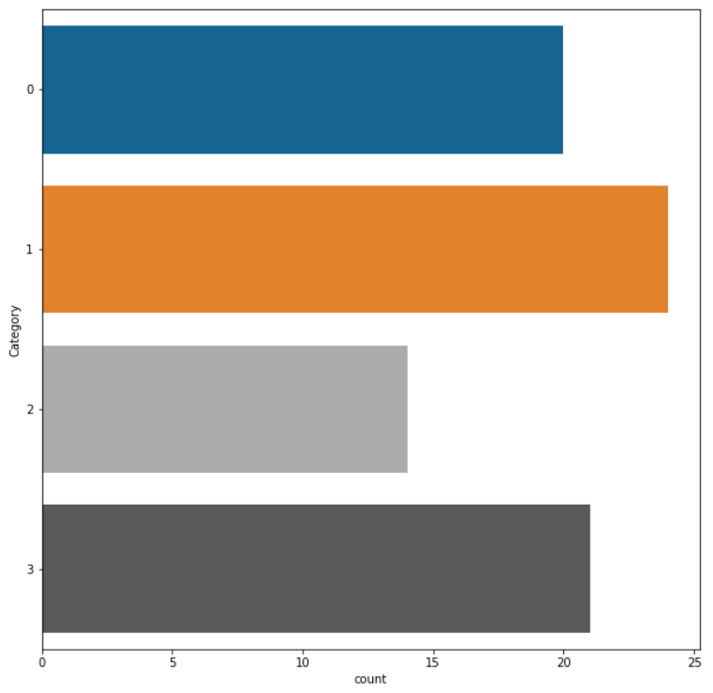
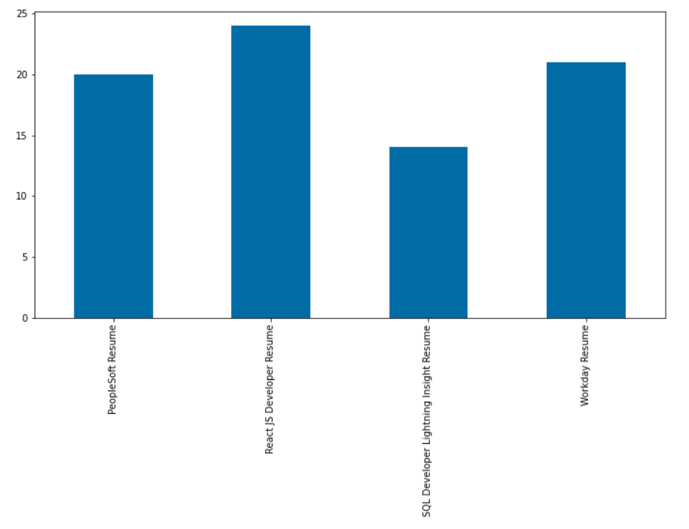
BOX PLOT
The below figure shows the no of applicants in each category.

Slide 10
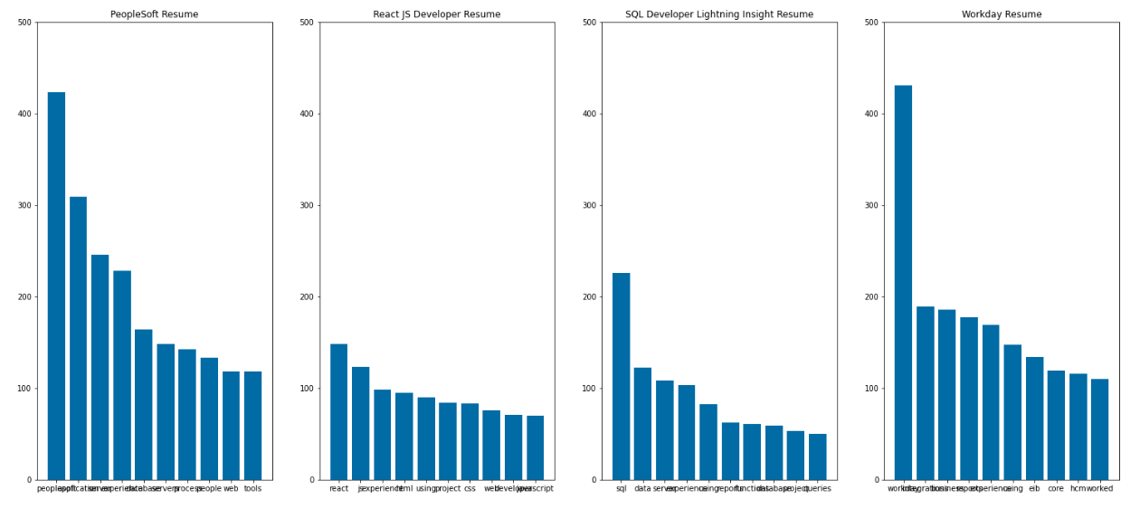
FREQUENCY OF WORD IN EACH CATEGORY

Slide 11
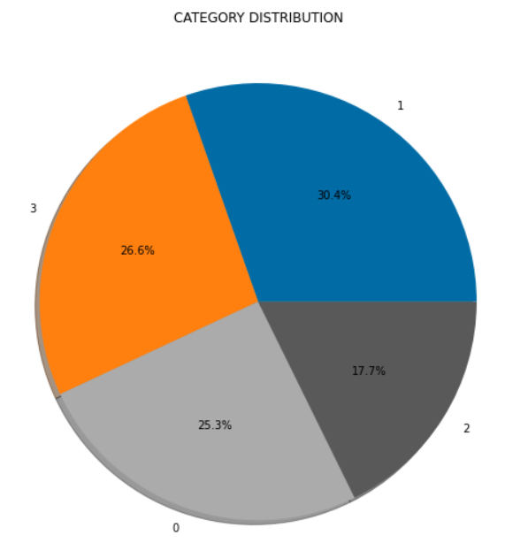
CATEGORY DISTRIBUTION THROUGH PIE CHART
The pie chart shows the no. of percentage of each category in the total applications.
0 is PeopleSoft Resume
1 is React JS Developer
Resume
2 is SQL Developer Lightning
Insight Resume
3 is Workday Resume

Slide 12
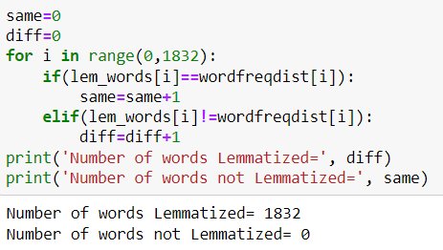
LEMMATIZATION
We use lemmatization for accuracy as our dataset is small.
The no of lemmatized words are 1832.

Slide 13
Model Building

Slide 14
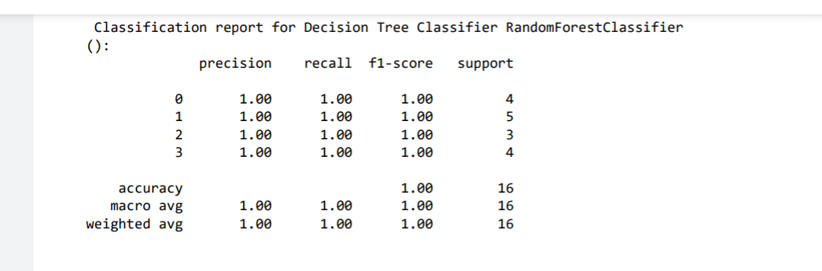
Random Forest Classifier

Slide 15
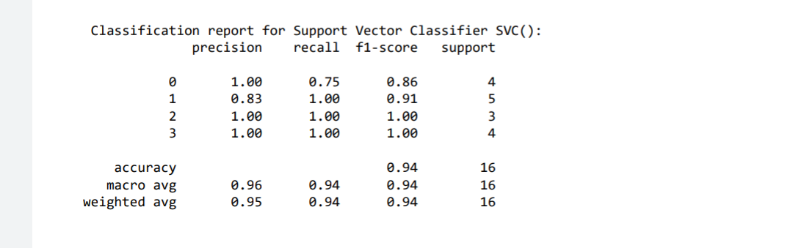
SVM Classifier

Slide 16
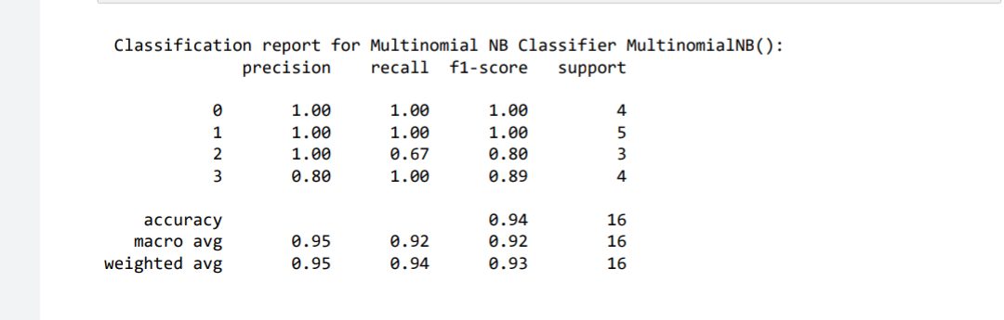
Multinomial NB Classifier

Slide 17
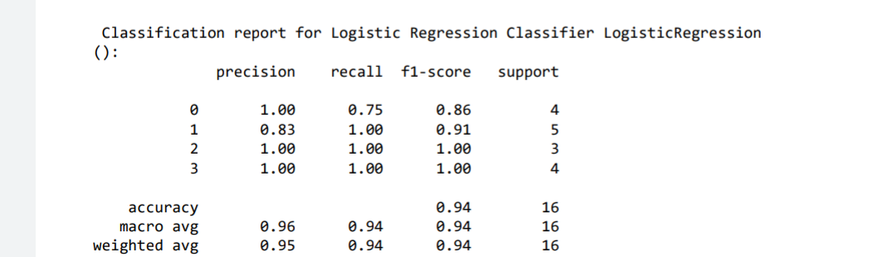
Logistic Regression Classifier

Slide 18
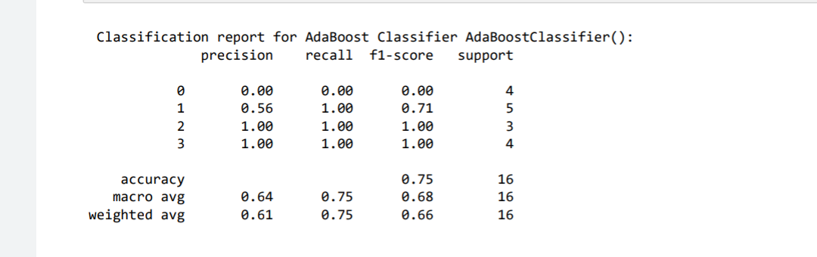
AdaBoost Classifier

Slide 19
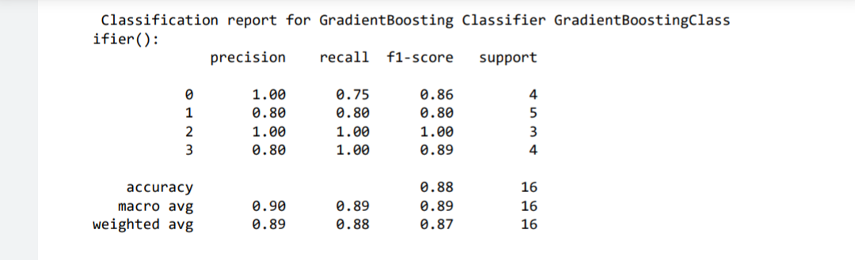
GradientBoosting Classifier

Slide 20
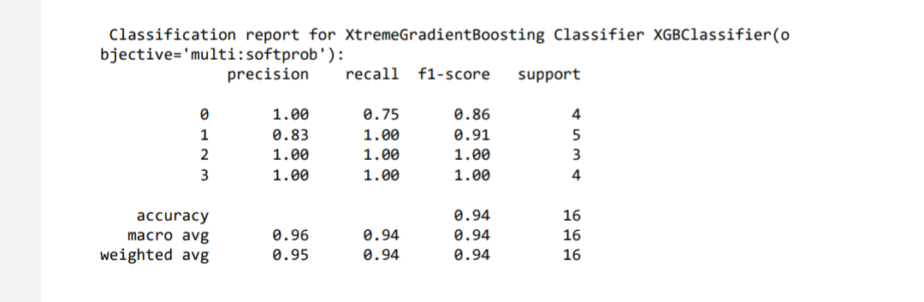
XtremeGradientBoosting Classifier

Slide 21
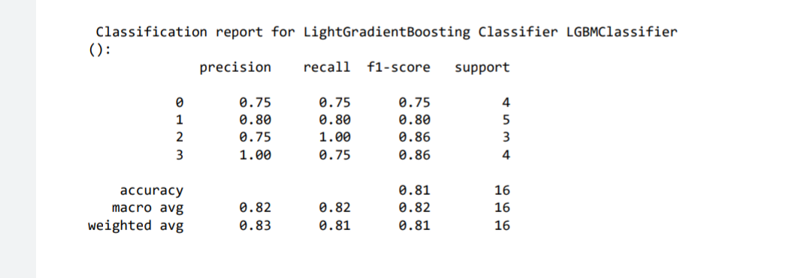
LightGradientBoosting Classifier

Slide 22
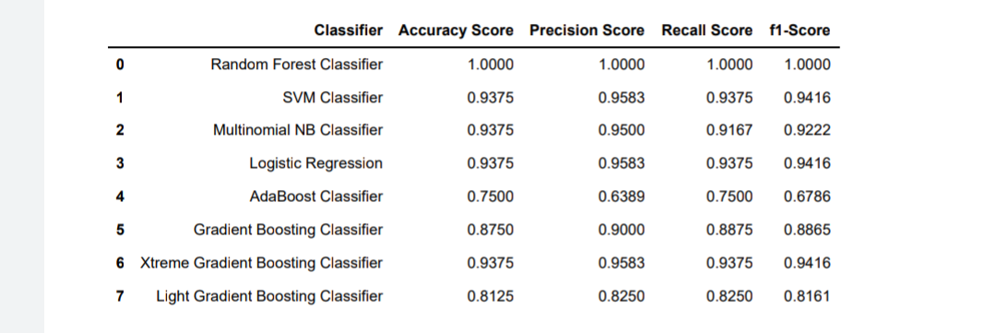
Model Evaluation

Slide 23
MODEL DEPLOYMENT
After the model building and Evaluation process , we have deployed
the code using “Streamlit”.
We have selected the S.V.M Classifier for the deployment.

Slide 24
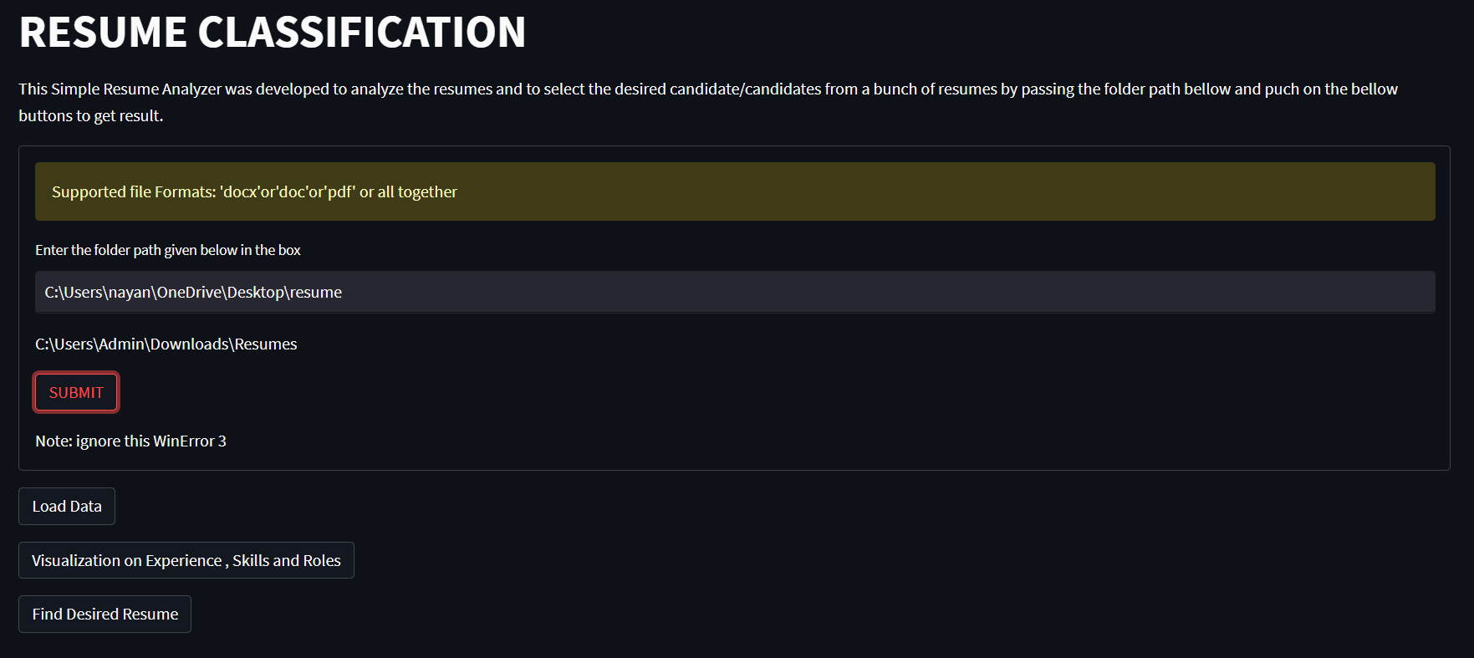
HOME PAGE OF THE WEB APP

Slide 25
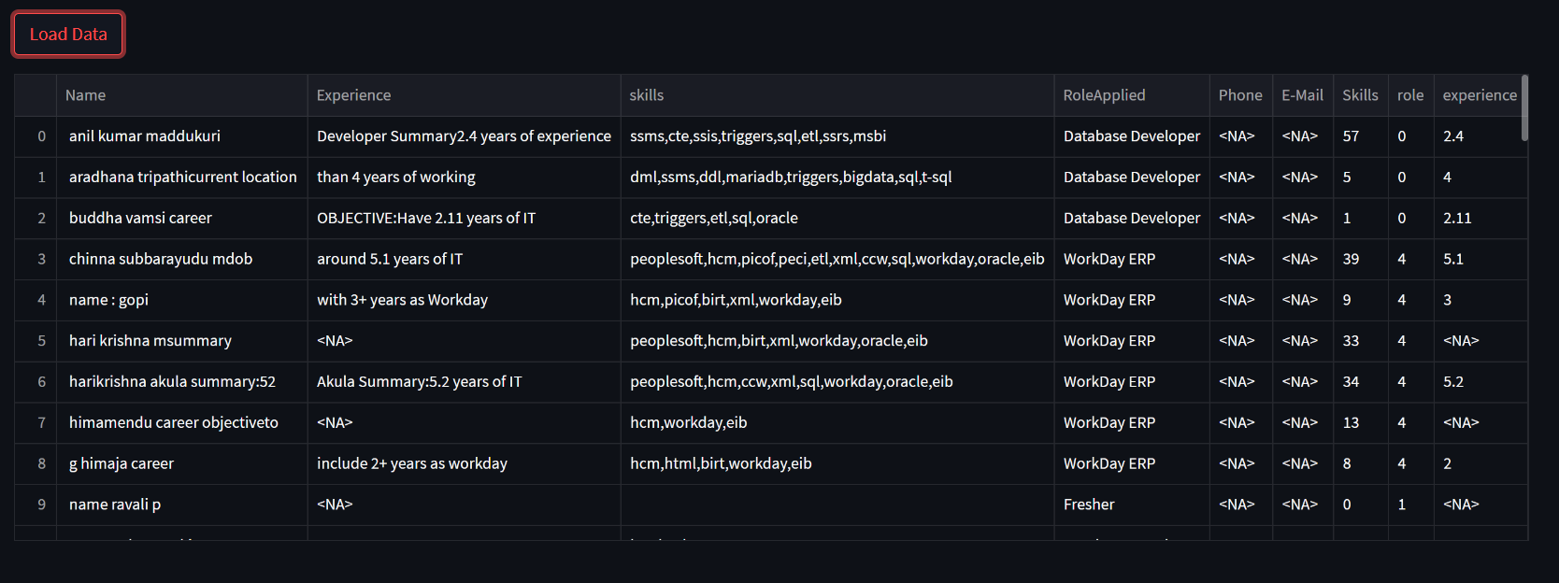

Slide 26
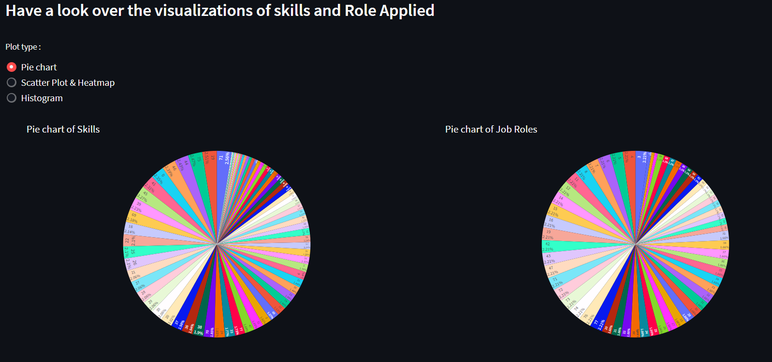
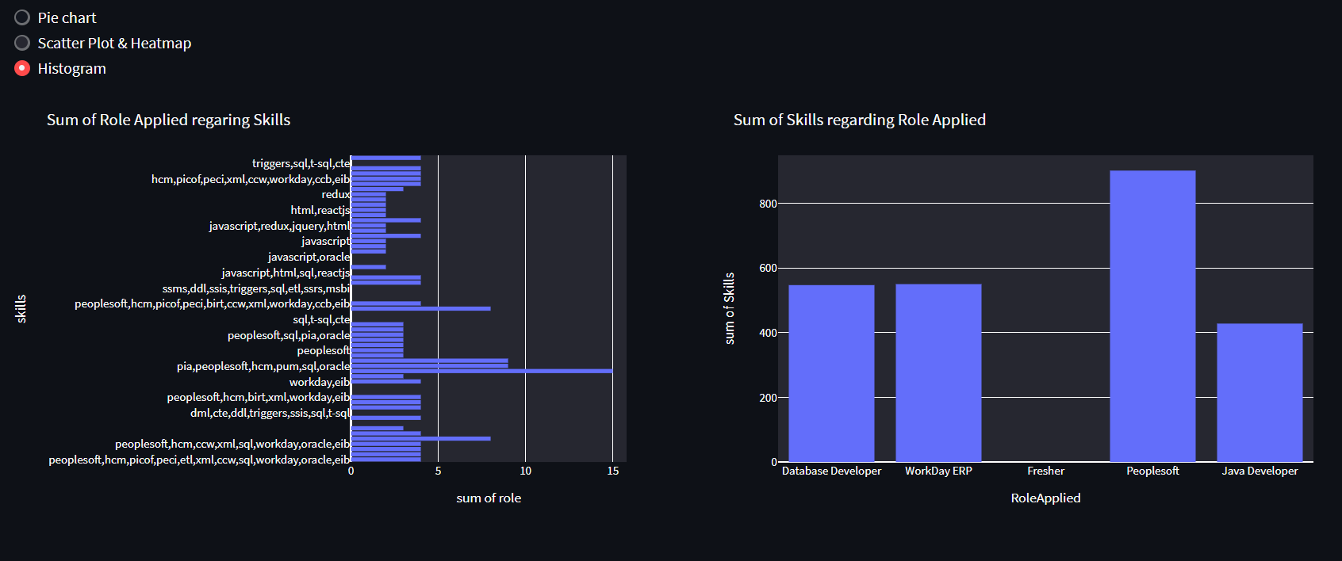

Slide 27
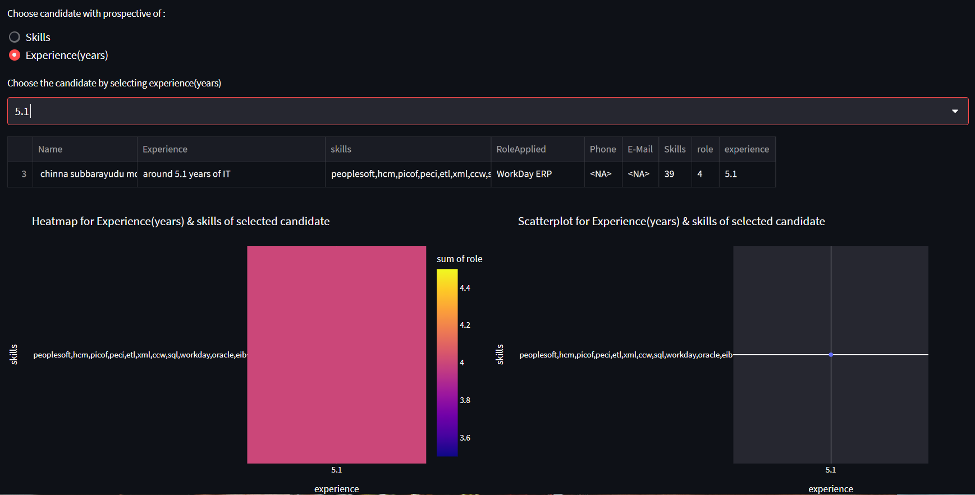

Slide 28
DIFFICULTIES WE FACE
First the data we are provided by the client was in docx and pdf format so extraction of data and making in to one frame is not easy for us.
As all the model shows nearly same result choosing the best model among all the model is difficult.
In the deployment stage we face the problem in extracting the data and giving the best result.
We also want to use the resume-parser for better result but we face a lots error on that.

